Slide 1
Literature review writing
Putra GOT 2018
Christopher Teh Boon Sung, Ph.D. (christeh@yahoo.com)
Dept. of Land Management, Fac. of Agriculture, UPM

Slide 2
What is a “literature review”?
Literature
  a collection of all the scholarly writings
    peer-reviewed articles, books, and other sources like conference proceedings, internal reports, and dissertations written by other graduate students
Must be relevant to a particular issue, area of research, or theory being researched
But what about newspaper, magazine, web, or blog articles?

Slide 3
Review of literature
  What's going on?
  analyze, discuss, interpret, and summarize past works and how they relate to your own work
Review must be objective, free of bias
  do not take “sides”, e.g., choosing to highlight only favorable results but burying unfavorable ones

Slide 4
Educational Resources Information Center (1982) defines a literature review as an
    “information analysis and synthesis, focusing on findings and not simply bibliographic citations, summarizing the substance of the literature and drawing conclusions from it.”
Literature review helps to establish a justifiable need for an outcome study

Slide 5
No review is perfect, complete, or all-encompassing
Every review has a “story” to tell and will be written to present that “story” to a targeted audience
  but still must be supported by evidence and be unbiased

Slide 6
Literature review is NOT …
a textbook
  where we aim to educate on well-known, established facts
  a learning material teaching the basics/fundamentals
  literature review assumes your readers are already experts or are experienced in your work/field of study
  a very common mistake among students

Slide 7
Literature review is NOT …
an annotated bibliography
  not a laundry list of summaries of the works you’ve read
  where we list citations to books, articles, and documents, where each citation is followed by a brief descriptive and evaluative paragraph, the annotation
  the purpose of the annotation is to inform the reader of the relevance, accuracy, and quality of the sources cited.
  also a very common mistake among students
a book review
  where we give an opinionated, often subjective evaluation of work done

Slide 8
Purpose of literature review
To determine current level of knowledge
  what do we know and don’t know – and why don’t we know it?
Determine
  knowledge gaps
  problems and issues
What others have done and what they found
  problems they have encountered
  their remarks on their study

Slide 9
For those applying for research grants or writing a dissertation:
  a well-written literature review shows that you are very well aware of
    the nature and scope of the problem,
    the importance of solving the problem,
    what others have done in solving the problem
    the knowledge gaps
    the difficulties of the study

Slide 10
According to Hart (1998):
  distinguishing what has been done from what needs to be done,
  discovering important variables relevant to the topic,
  synthesizing and gaining a new perspective,
  identifying relationships between ideas and practices,
  establishing the context of the topic or problem,
  rationalizing the significance of the problem,
  enhancing and acquiring the subject vocabulary,

Slide 11
  understanding the structure of the subject,
  relating ideas and theory to applications,
  identifying the main methodologies and research
  techniques that have been used, and
  placing the research in a historical context to show familiarity with state-of-the-art developments

Slide 12
Four stages (like conducting a research!)
Problem formulation
    which topic or field is being examined and what are its component issues?
Literature search
    finding materials relevant to the subject being explored
Data evaluation
    determining which literature makes a significant contribution to the understanding of the topic
Analysis and interpretation
    discussing the findings and conclusions

Slide 13
1. Problem formulation
Determine central questions because they will guide your review process
Questions depend on the goal and focus of the review
For example, if the goal of the review is to integrate research outcomes, then a meaningful research question might be: From the previous literature, what is the effect of intervention X on outcomes Y and Z?

Slide 14
But if the goal is to analyze the research methods, questions might include: What research methods have been used in the past to investigate phenomenon X? and What are the methodological flaws of those methods?
And if the literature review focus is on theories and the goal is to identify central issues, then a legitimate research question might be: What are the central theories that have been used to explain phenomenon X?

Slide 15
American Education Research Association (2006):
  If the study is a contribution to an established line of theory and empirical research, it should make clear what the contributions are and how the study contributes to testing, elaborating, or enriching that theoretical perspective.
  If a study is intended to establish a new line of theory, it should make clear what that new theory is, how it relates to existing theories and evidence, why the new theory is needed, and the intended scope of its application.

Slide 16
If the study is motivated by practical concerns, it should make clear what those concerns are, why they are important, and how this investigation can address those concerns.
If the study is motivated by a lack of information about a problem or issue, the problem formation should make clear what information is lacking, why it is important, and how this investigation will address the need for information.

Slide 17
2. Literature search
Always emphasize on credible sources
  peer-reviewed, high impact scientific journals
  books by reputable publishers
Understand some sources are not or are weakly peer-reviewed
  such as magazines, newspapers, blogs
  even some journals and books
Some studies are mostly published in so-called “gray literature”
  not easily/widely available
  e.g., local seminars/conference proceedings
  internal reports

Slide 18
Your field of study may be very new or seldom done
  sparse directly related sources
Not wrong to cite articles from newspapers, magazines, blogs, or web – but try to avoid if possible
  or use alternatives such as finding the journal/book related to the article
  de-emphasize the importance of the source

Slide 19


Slide 20

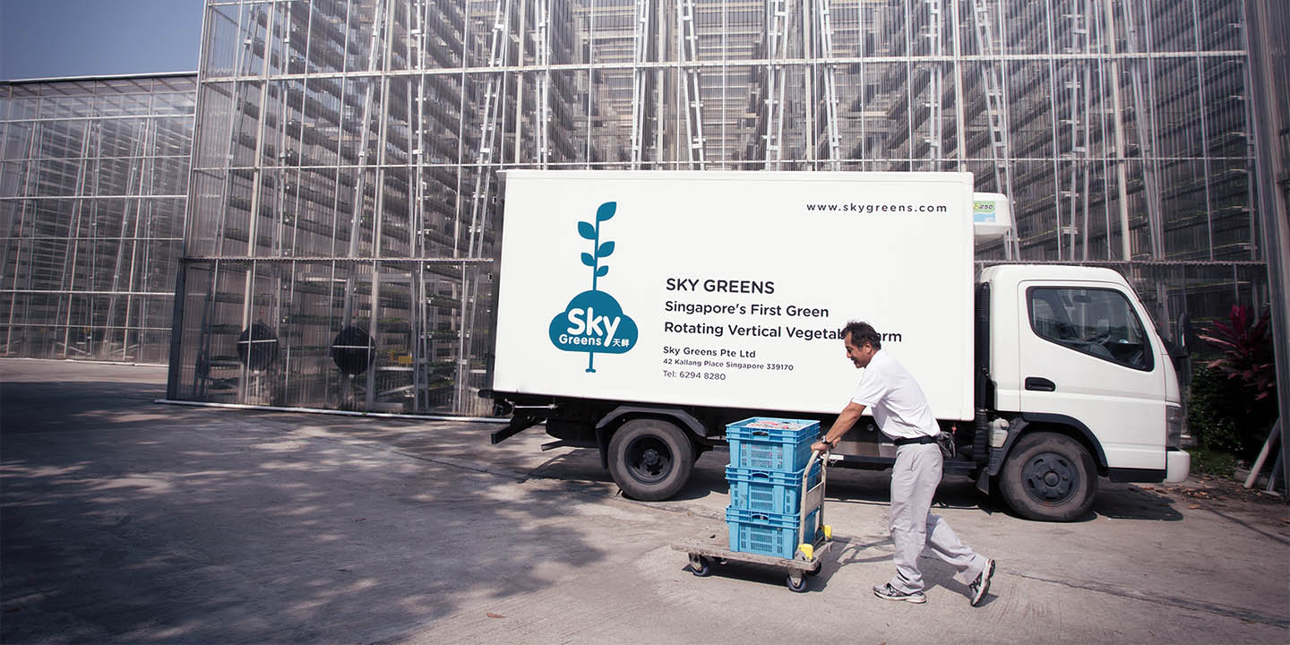
(Source: Sky Greens 2017 Krishnamurthy, R. 2014. “Vertical Farming: Singapore’s Solution to Feed the Local Urban Population.” Permaculture Research Institute. Accessed 2 February 2017. http://permaculturenews.org/2014/07/25/vertical-farming-singapores-solution-feed-local-urban-population).

Slide 21
Sources used instead:
Benke, K. & Tomkins, K. 2017. Future food-production systems: vertical farming and controlled-environment agriculture. Journal Sustainability: Science, Practice and Policy. 13: 13-26.
Despommier, D. 2010. The Vertical Farm: Feeding the World in the 21st Century. New York: Picador.

Slide 22
3. Data evaluation
Sources must be scientifically rigorous
  Are the arguments supported by evidence?
  Did the study use the correct statistical analysis/method?
    look at the means, s.d., or s.e. – are they reasonable?
  Was the study objective?
    Was contrary data considered or was certain pertinent information ignored?
What are the study weaknesses?
  not always explicitly stated
Does the work ultimately contribute in any significant way to an understanding of the subject?

Slide 23
4. Data analysis and interpretation
Make sense of the data and results from the various studies
Sometimes you may have to reanalyze their data, even in some limited way

Slide 24
From the table, we can work out the oil palm water uptake follows the 4:3:2:1 trend as suggested by another researcher: Miyazaki (2005).

Slide 25
Use Table 1 data to work out the oil palm leaf area index (LAI) to now relate LAI instead with canopy gap fraction.

Slide 26
Four processes in writing the review
Provide an overview of the subject, issue, or theory under consideration, along with the objectives of the literature review
Divide studies into categories
  those in support of a particular position, those against, and those offering alternative theses entirely
Explain how each work is similar to and how it varies from the others
Conclude as to which pieces are best considered in their argument, are most convincing of their opinions, and make the greatest contribution to the understanding and development of their area of research

Slide 27
Very important to …
describe the relationship of each work to the others under consideration
  try to distinguish studies into groups, where each group talks about one particular theme/trend

Slide 28
Very important to …
identify gaps in previous research
try to resolve conflicts between contradictory previous studies
  or at least be able to explain contradictory studies
place one's original work in the context of existing literature
identify areas of work to prevent duplication of effort
point the way forward for further research

Slide 29
Writing approach
Can follow either chronological or thematic approach
Chronological
  group and discuss the sources in order of their publication date
    from the earliest to the latest
  useful for studies on research methodology or historical studies, in which you want to emphasize how ideas have developed over time
  not recommended for most cases, especially for dissertations or scientific papers
  though useful in some cases for popular science writing

Slide 30
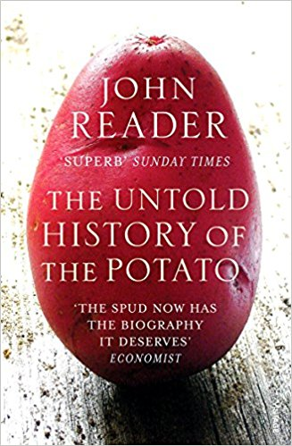
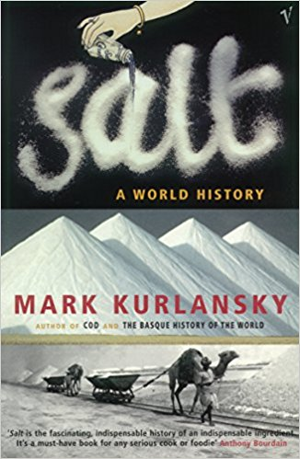
Popular science books: chronological writing approach

Slide 31
Thematic approach
  recommended but the hardest to write
  group and discuss your sources in terms of overall themes or trends
  determine the overall trends or themes from all the materials you read
  not a list of who-said-what-and-when
    can be very boring to read and hard to follow because you do not show how and where the various studies fit or are related to one another

Slide 32
A very simple (and trivial) example of who-said-what-and-when:
    “Teh (2016) found that N was an important plant nutrient. Jamal et al. (2014) in their work in Iran reported that use of P increased their crop yield. Furthermore, Ali and Tan (2000) remarked K was also an essential plant nutrient.”
Better to write simply as:
    “N, P, and K were found to be essential nutrients for crops (Teh, 2016; Jamal et al., 2015; Ali and Tan, 2000).”

Slide 33
Tell the story, make your case
  Decide what is your story – and focus all your writing to tell that story
Use your own words
  Have only one “voice” in your writing
  Many “voices” when we copy-and-paste
  Or no “voice” when your writing is dull
Talk to your audience
Make connections for your readers
  Do not make your readers infer what you are trying to tell them

Slide 34
Cite accurately
  Do not plagiarize – whether by intention or accident
  Do not assume web sources are public domain
    seek permission to use, even if to modify
    check copyrights and royalties
  Follow the citation format
    APA (American Psychological Association) style

Slide 35
What’s the problem?
“In general, rice is known to be a staple food in Taiwan. The Taiwan Council of Agriculture states that there were originally no indigenous species of rice from Taiwan. Rice cultivation and technology was brought into Taiwan before the Qing Era. Shortly after, the Indica rice became the most productive and efficiently-grown rice grain, especially because of the ample construction of water reservoirs near rice fields during the Japanese colonial period.”

Slide 36
Common mistakes
does not clearly relate the findings of the literature review to the researcher’s own study;
does not take sufficient time to identify or find the best sources to use;
relies on secondary sources rather than on primary sources;
uncritically accepts another researcher’s findings and interpretations as valid, rather than examining critically all aspects of the research design and analysis;
does not consider contrary findings and alternative interpretations in synthesizing quantitative literature

Slide 37
writing a narrowly-focused literature review
textbook or annotated bibliography writing
irrelevant content
bad organization and structure
repetitive facts
dull, very tedious writing
relying on direct quotations
poor language command

Slide 40
Tools
Be organized by keeping track of your sources
  hardcopies have a filing system
Store softcopies in your computer using some sort of organization
  like folders named after topics/themes/dates
Use software tools like Endnote, Refworks, Mendeley (free), etc.
  many websites now can export citations to you (saves you typing)
Lastly, …
  START READING EARLY, not only when it is time to write your dissertation

Slide 41
References
American Education Research Association. 2006. Standards for reporting on empirical social science research in AERA publications. Educational Researcher, 35(6), 33-40.
Educational Resources Information Center. 1982. ERIC processing manual (Section 5: Cataloging). Washington, DC.
Hart, C. 1998. Doing a literature review: Releasing the social science research imagination. London: Sage.
Randolph, J. 2009. A Guide to Writing the Dissertation Literature Review. Practical Assessment, Research & Evaluation, 14(13): 1-13.
Write a Literature Review by Uni. of California Santa Cruz (https://guides.library.ucsc.edu/write-a-literature-review)
Avoiding Common Errors in your Literature Review; October 29, 2016 by Dissertation Genius (https://dissertationgenius.com/avoiding-common-errors-literature-review/)

